Slide 1
Valve Reoperation after Native and Valve-in-Valve Transcatheter Aortic Valve Replacement: A Statewide Experience
Shinichi Fukuhara, MD (1,4,5), Stephane Leung, MD (2,4,5), Daizo Tanaka, MD (3,4), Devraj Sukul, MD (1,5), P. Michael Grossman, MD (1,5), Stanley J. Chetcuti, MD (1,5), Chang He, PhD (4,5), Melissa Clark, MSN (4,5), Himanshu J. Patel, MD (1,4,5)
1. University of Michigan Cardiovascular Center, Ann Arbor, MI, 2. Spectrum Health, Grand Rapids, MI, 3. Henry Ford Hospital, Detroit, MI, 4. Michigan Society of Thoracic and Cardiovascular Surgeons Quality Collaborative, Ann Arbor, MI, 5. Michigan Structural Heart Consortium, Ann Arbor, MI

Slide 2
Disclosures
Shinichi Fukuhara: Consultant for Terumo Aortic, Medtronic Inc. Steering committee for Artivion PERSEVERE trial
Himanshu Patel: Consultant for Medtronic Inc.
Stanley Chetcuti: Consultant for Medtronic Inc, Jena, Biotrace.
Others have nothing to disclose.

Slide 3
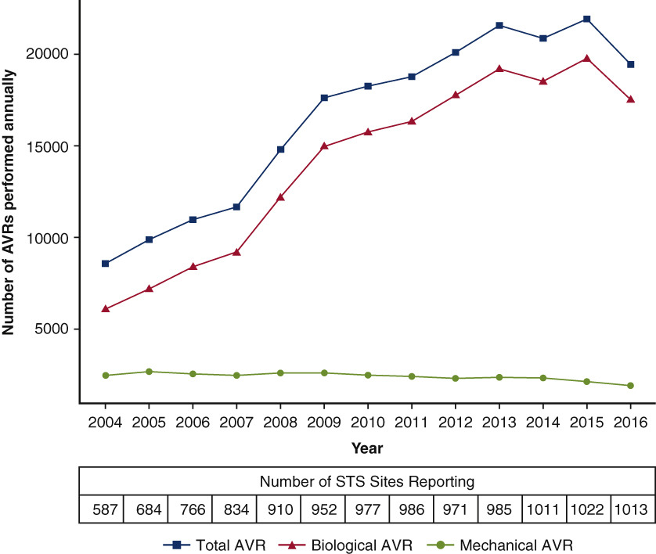
Introduction
The use of bioprostheses during SAVR has increased substantially [1], expecting future valve-in-valve TAVR (VIV-TAVR).
There are scant data regarding reoperations following VIV-TAVR.
Bioprosthetic SAVR
Mechanical SAVR
1. Tam DY, et al. Surgical valve selection in the era of transcatheter aortic valve replacement in the Society of Thoracic Surgeons Database. J Thorac Cardiovasc Surg. 2020;159:416-427.

Slide 4
Objectives
We sought to investigate the characteristics and implications of patients undergoing aortic valve reoperations after native TAVR and VIV-TAVR.

Slide 5
Cohort
Index TAVR data captured in patients with reoperation

Slide 6
Trend

Slide 7
Frequency of Reoperation Native TAVR VS VIV-TAVR
1/3 of reoperations were VIV-TAVR cases
Frequency: 7 times higher in VIV-TAVR
No difference in the incidence between stented vs stentless VIV-TAVR

Slide 8
Demographics
Characteristic | TAVR-in-SAVR (n=19) | Native TAVR (n=41) | P-value
Age (years) | 73.0 (65.5 – 77.5) | 72.0 (68.0 – 76.0) | 0.66
Female | 6 (32) | 13 (32) | 0.99
Dialysis | 0 | 7 (17) | 0.086
Permanent pacemaker | 0 | 21 (51) | < 0.001
Prior sternotomy | 19 (100) | 17 (42) | < 0.001
NYHA class III/IV | 13 (68) | 29 (71) | 0.86
STS-PROM (%) | 5.8 (2.8–9.2) | 9.9 (5.1–15.6) | 0.084

Slide 9
Previous SAVR Valve Type
Previous surgical bioprosthesis | TAVR-in-SAVR (n=19)
Stented bioprosthesis | 11 (58)
Labeled valve size (mm) | 24.0 (22.5 – 27.5)
Stentless bioprosthesis | 8 (42)
Labeled valve size (mm) | 27.0 (25.5 – 28.5)

Slide 10
Index TAVR
Characteristic | TAVR-in-SAVR (n=19) | Native TAVR (n=41) | P-value
Time to reoperation (Years) | 2.0 (0.5–4.0) | 0.8 (0.3–2.4) | 0.25
Index TAVR device type |  |  | 0.014
Balloon-expandable | 3 (16) | 20 (49)
Self-expandable | 16 (84) | 21 (51)
Valve size (mm) | 29 (23–29) | 29 (26–34) | 0.11

Slide 11
Primary Indication for Reoperation
Indication for Reoperation | TAVR-in-SAVR (n=19) | Native TAVR (n=41) | P-value
AS | 8 (42) | 11 (27) | 0.24
AI/PVL | 15 (79) | 18 (44) | 0.013
Primary aortic aneurysm | 2 (11) | 0 | 0.097
Endocarditis | 0 | 10 (24) | 0.023
Hemolysis | 0 | 1 (2) | 1.00
Structural issues caused by TAVR valve | 4 (21) | 7 (17) | 0.73
Mitral impingement | 2 (50) | 4 (57) | 1.00
Coronary obstruction due to late migration | 2 (50) | 0 | 0.11
Secondary aortic dissection/aneurysm | 0 | 2 (29) | 0.49
VSD | 0 | 1 (14) | 1.00

Slide 12
Operative Data
 | TAVR-in-SAVR (n=19) | Native TAVR (n=41) | p-value
Cardiopulmonary bypass time (minutes) | 193 (126 – 280) | 155 (102 – 237) | 0.55
Cross-clamp time (minutes) | 184 (115 – 235) | 142 (86 – 182) | 0.33
Concurrent procedures
Annulus/aortic root enlargement | 2 (11) | 2 (5) | 0.63
Mitral repair/replacement | 4 (21) | 17 (42) | 0.12
CABG | 1 (5) | 8 (26) | 0.13
Tricuspid repair/replacement | 2 (11) | 6 (15) | 0.66
Aortic repair | 9 (47) | 9 (22) | 0.046
Aortic root repair | 7 (37) | 7 (17) | 0.092
Ascending aortic repair | 5 (26) | 4 (10) | 0.13
Aortic arch repair | 1 (5) | 2 (5) | 1.00
VSD repair | 0 | 1 (2) | 1.00

Slide 13
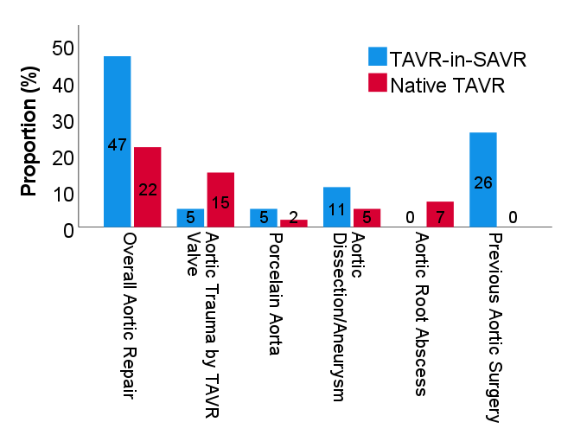
Aortic Repair Reasons
High aortic repair rate in VIV-TAVR group driven by previous aortic root surgery
TAVR explant trauma-related aortic repair was rare in patients with previous SAVR

Slide 14
Postoperative Outcomes
 | TAVR-in-SAVR (n=19) | Native TAVR (n=41) | p-value
30-day mortality | 2 (11) | 7 (17) | 0.71
O/E ratio | 1.9 | 1.7 | 0.88
Stroke | 0 | 2 (5) | 1.00
Prolonged mechanical ventilation | 6 (32) | 12 (29) | 1.00
Renal failure requiring new dialysis | 2 (11) | 5 (15) | 1.00
Permanent pacemaker | 3 (16) | 1 (5) | 0.34
Chest exploration for bleeding | 2 (11) | 2 (5) | 0.59
Discharge location |  |  | 0.31
Home | 12 (71) | 19 (56)
Extended care/rehabilitation facility | 5 (29) | 15 (44)

Slide 15
Summary
Approximately one third of reoperations were VIV-TAVR cases, which demonstrated exceedingly higher rate of reoperation compared with native TAVR.
This fact challenges the worldwide trend of favoring bioprosthetic SAVR and presumptive future TAVR-in-SAVR concept.
The frequent aortic repair during TAVR-explant in VIV-TAVR group appears mostly unrelated to TAVR explant trauma.

